Slide 1

FAANG Analysis & Price Forecasting using Time Series Models
By,
Varshita Adavi (OC83614)
Srinivas Naidu Pasyavula (QC61851)

Slide 2
Introduction
FAANG – Facebook, Apple, Amazon, Netflix, Google
Market Index – S&P 500
Analysis of all the above companies
Comparing the stock values
Estimating the return values
Creating a portfolio of FAANG
Representing the Efficient Frontier

Slide 3
Dataset
Yahoo Finance
Time Period: Jan 01, 2022 - Jan 01, 2023
Market Index – S&P500 (GSPC)
Companies:
Apple - AAPL
Amazon - AMZN
Google - GOOGL
Facebook - META
Netflix – NFLX

Slide 4
Data Processing
Loading the data
Exploratory Data Analysis
Graphical Representation of the data
Illustrating the correlation among the companies

Slide 5
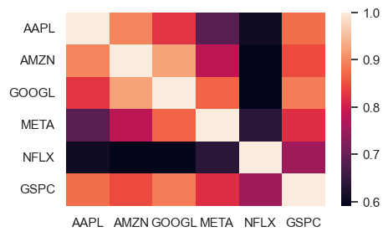
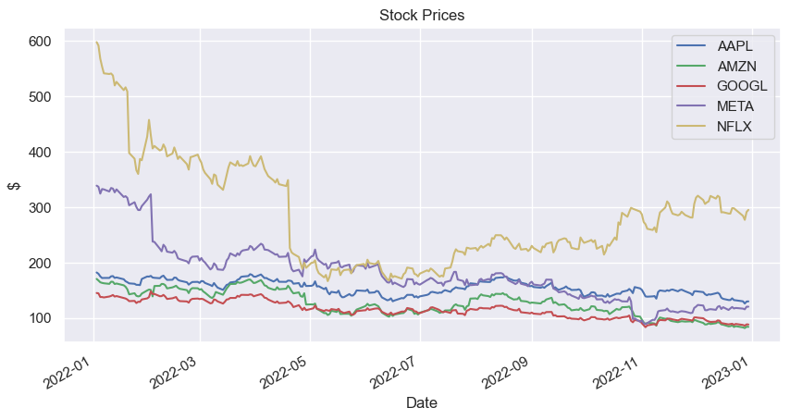
Graphical Representation

Slide 6
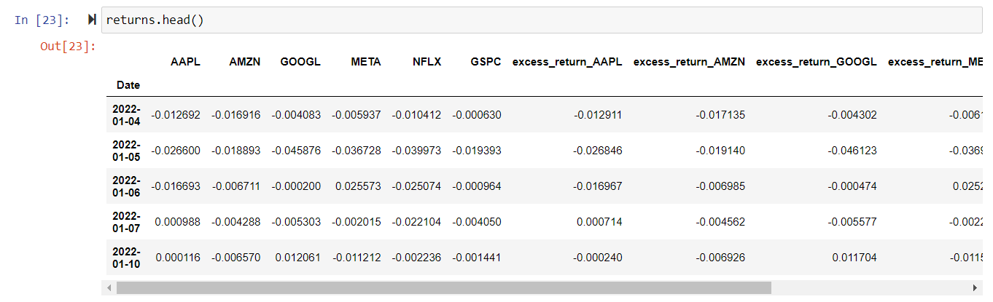
Calculating the returns
The returns value is being calculated.
Fred API key
Daily risk-free rate

Slide 7





Capital Asset Model
APPLE
NETFLIX
AMAZON
FACEBOOK
GOOGLE

Slide 8
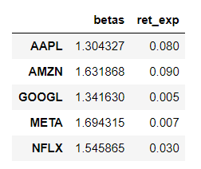
Security Market Line
Graphical representation of CAPM.
Determines if an asset can provide a profitable outcome compared to the level of the risk while investing.
If the beta value is less than 1, it indicates that the asset returns are less volatile than the market.

Slide 9
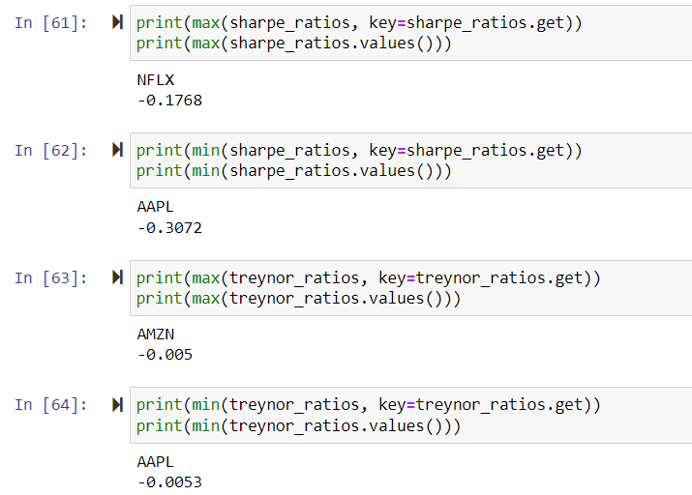
Sharpe ratio and Treynor ratio
According to Sharpe Ratio, the lowest Sharpe ratio indicates that it assumes higher risk per return relative to other stocks considered.
According to the Treynor ratio, a higher Treynor ratio is typically seen as better than a lower one.

Slide 10
Efficient Frontier
It represents the optimal tradeoff between risk and returns for a given set of assets or securities.
Portfolios that lie on the efficient frontier are efficient portfolios because they provide the highest expected return for a given level of risk or the lowest level of risk for a given level of expected return.
Portfolios that lie below the efficient frontier are suboptimal because they provide a lower expected return for a given level of risk.
Apple – Efficient portfolio
Amazon, Google, Netflix, Facebook – Suboptimal portfolio

Slide 11
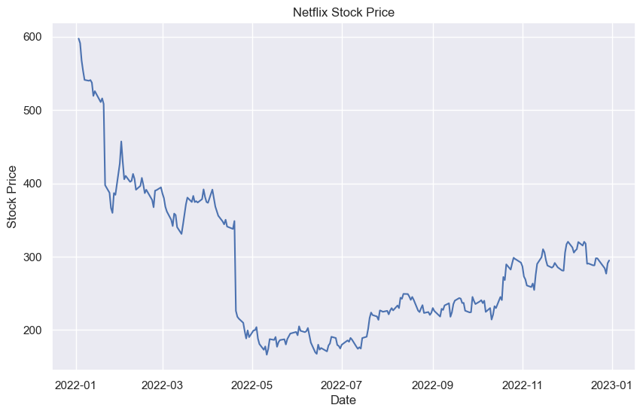
Time Series Model for Netflix

Slide 12
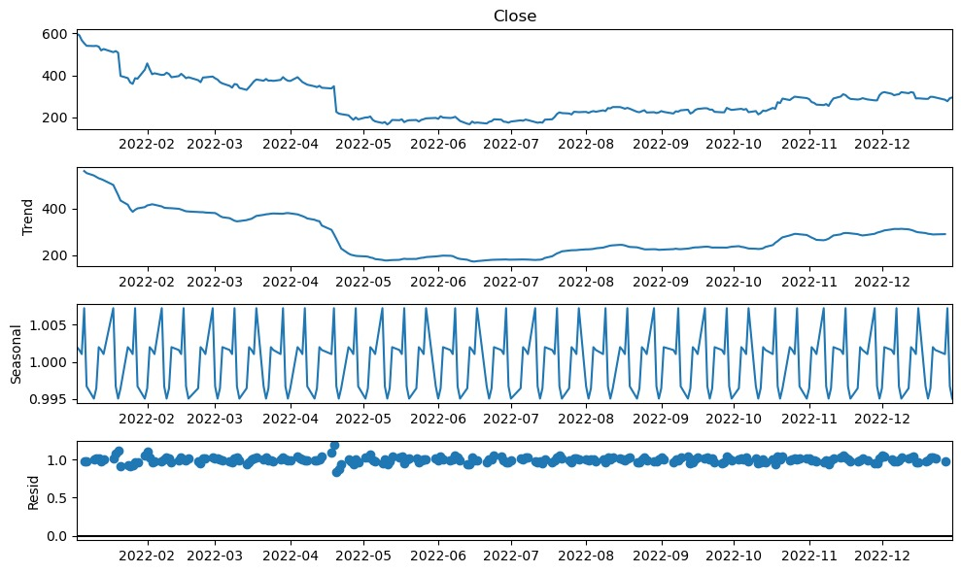
Time Series components: Trend, seasonality, cyclicality, and noise

Slide 13
Time Series components: Trend, seasonality, cyclicality, and noise
In the first graph, we see the behavior of the raw data. Overall, it has a downward trend despite a small rise at the end quarter of 2022.
The second plot exhibits the `trend` of the data. The trend shows the overall movement of a time series. We can say that there exists a trend if there is a long-term increase or decrease in the data. So, we need to focus on the mean of the data at the beginning and end of the period to detect the trend.
`Seasonality` is the third plot which shows periodical ups and downs in the data. If there is a seasonality in the data, it should also be removed. For instance, sales of a winter wear company go down during summer and go up during winter. It indicates quarterly seasonality. Seasonality might be weekly, monthly, quarterly, or yearly.
The last graph shows the `residuals`. This is obtained after removing the trend and seasonal components from the time series. If we end up with a rather stable residual, it means that our data is stationary structure and ready to move on to the modeling part. At first glance, the highly volatile distribution of the residual indicates that the data is not stationary.
Final time series component, which is not on the graph is `cyclicality`. It exists when higher periodic variation than the trend emerges. We can, however, think of cyclicality as business cycles, which take a long time to complete their cycles and the ups and downs are over a long horizon. So, cyclicality is different from seasonality in the sense that there is no fluctuation in a fixed period.

Slide 14
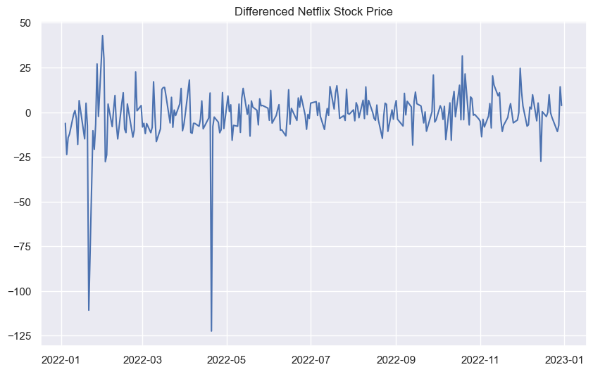
Detecting and handling with stationarity
Stationary is a way to model the dependent structure that we have in time-dependent data. For instance, the current stock price is somewhat related to the previous prices of the stock.
Statistical Test for detecting stationarity: ADF
Statistical tests provide us with a robust method to detect stationarity. In this part of the class, we will talk about a statistical method in detecting stationarity: Augmented Dickey-Fuller (`ADF`)

Slide 15
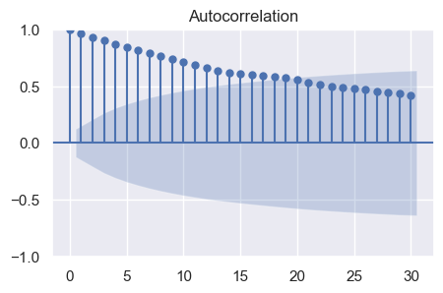
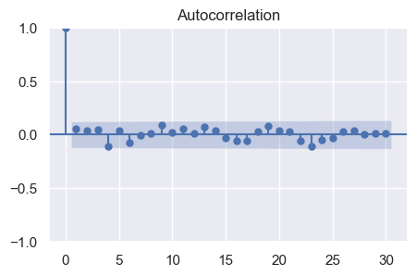
Autocorrelation Function (ACF)
The `acf` plot indicates that acf is slowly decaying, which is an indicator of non-stationarity. Besides, the blue shaded area represents the confidence interval. If the bar is in this confidence interval, it indicates that there is no significant correlation between this lag and the current one and this information is used for identifying the optimal lag. As this data is non-stationary, it makes no sense to apply this information here.
The above-given acf plot exhibits that there is a spike at the 9th, 11th, and 13th lags. Larger lags work better. Here, I pick the 13th lag.

Slide 16
Partial Autocorrelation Function (PACF)
PACF provides information on the correlation between the current value of a time series and its lagged values controlling for the other correlations.
The result that we get from PACF is similar to what we have in ACF. So, pick the 13th lag. We are going to use this lag structure in our time series model.
In moving average, ACF is used for this Project. As for the Autoregressive Integrated model Average, PACF is the tool used.

Slide 17
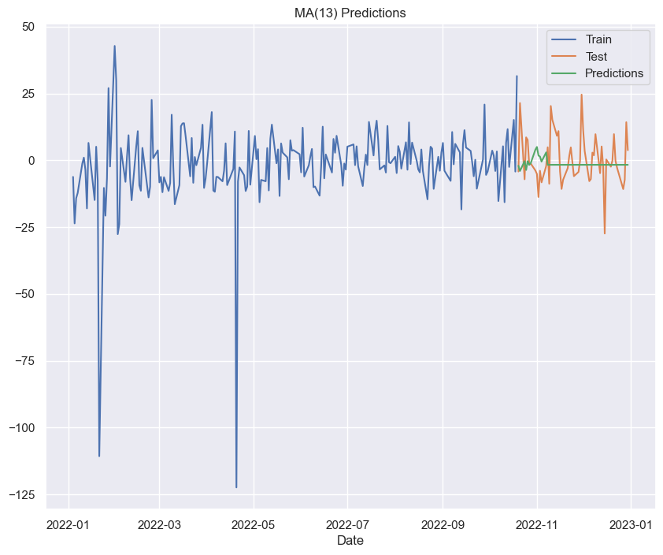
Moving Average Model (Predictions)
Moving Average Model tries to capture the time series dynamics simply by error terms. Let $e_t$ is a normally distributed term, meaning that it is identically and independently distributed (iid). So, unlike AR, MA is always stationary.

Slide 18
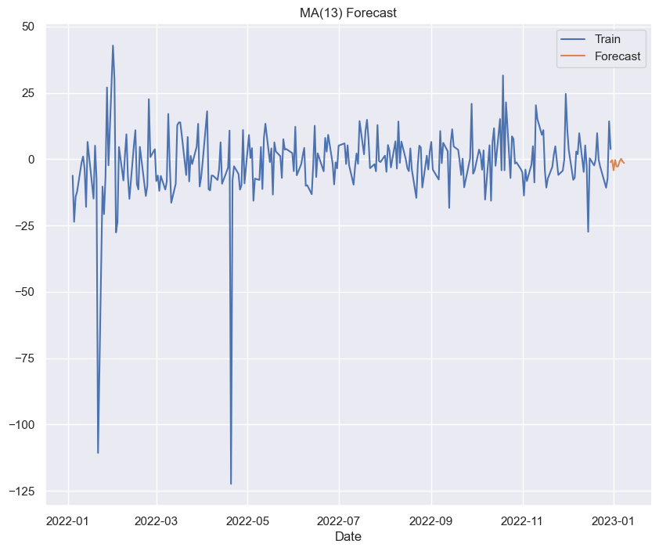
Moving Average Model (Forecast)
The moving Average Model is forecasting that the stock price can be downward and can go down in the near term.

Slide 19
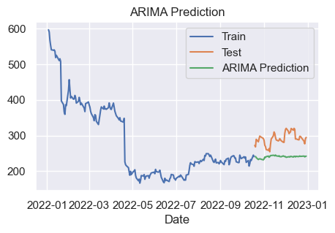
Autoregressive Integrated Moving Average (Prediction)
ARIMA(p,d,q) has three parameters, and one of them is for making a series stationary.
ARIMA model is predicting that the stock price is flat and has a slight upward trend.

Slide 20
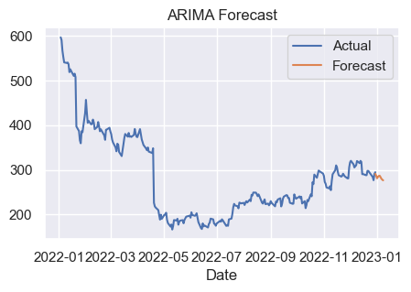
Autoregressive Integrated Moving Average(Forecasting)
ARIMA model is forecasting that the price of Netflix stock can go down in the near term.

Slide 21
Conclusion
Moving Average Model:
The Moving Average Model forecasting that the stock price can be downward and can go down in the near term.
Autoregressive Integrated Moving Average Model
ARIMA model is forecasting that the price of Netflix stock can go down in the near term.
In summary both models are forecasting the same and the stock price of Netflix’s trend is downward.
Based on the metrics, it appears that the ARIMA model (with MAE of 7.32563, MSE of 95.939804, and RMSE of 9.794887) performs better than the MA model (with MAE of 7.709611, MSE of 102.969777, and RMSE of 10.147402).

